Slide 1
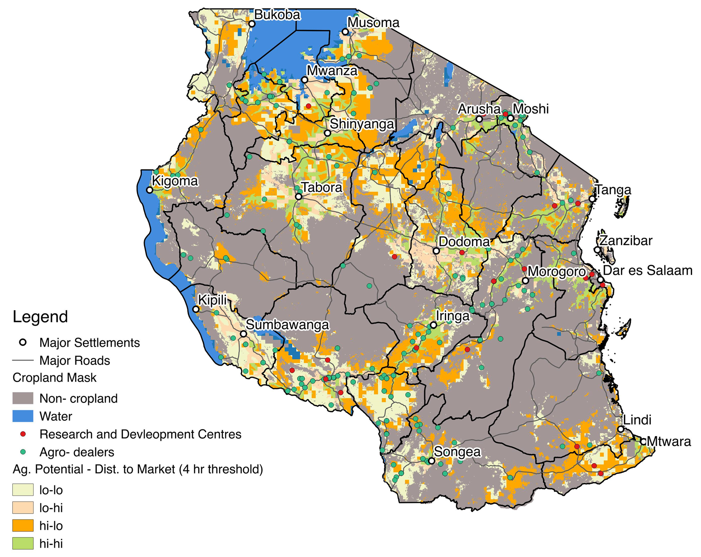
Tanzania: 2 x 2 Segmentation (Ag. Potential – Distance to market)
Category | Units | Lo-Lo | Lo-Hi | Hi-Lo | Hi-Hi | Total
N (Tanzania) | # | 593 | 459 | 825 | 724 | 2,601
HH (Tanzania) | # | 1,296,146 | 916,976 | 1,656,602 | 1,519,259 | 5,388,982
HH (Tanzania) | % | 24% | 17% | 31% | 28% | 100%
Note: Sample size (N) and extrapolated # HH are only SHF (< 4 ha)
Sources: Major Settlements, Water – Natural Earth, 2016; Cropland Mask – AfSIS, 2015; Land Suitability – FAO/IIASA; Travel Time – HarvestChoice 2015

Slide 2
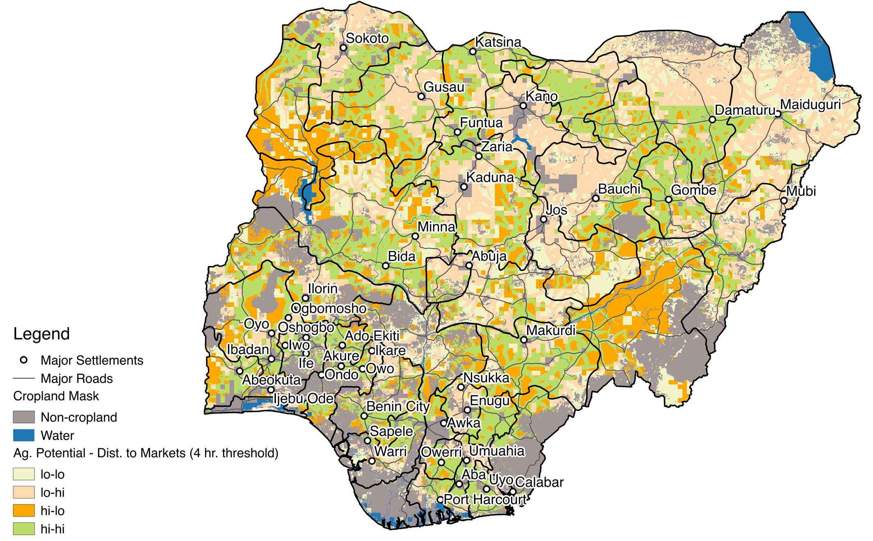
2x2 Segmentation (Ag. Potential – Distance to market): Nigeria
Category | Units | Lo-Lo | Lo-Hi | Hi-Lo | Hi-Hi | Total
N (Nigeria) | # | 119 | 841 | 244 | 1,259 | 2,463
HH (Nigeria) | # | 607,667 | 5,035,820 | 1,091,219 | 7,183,987 | 13,918,693
HH (Nigeria) | % | 4% | 36% | 8% | 52% | 100%
Note: Sample size (N) and extrapolated # HH are only SHF (< 4 ha)
Sources: Major Settlements – Natural Earth, 2016; Water Bodies – Digital Chart of the World, 2000; Land Suitability – FAO & IIASA, 2007; Travel Time – HarvestChoice ,2015
Notes:
2

Slide 3
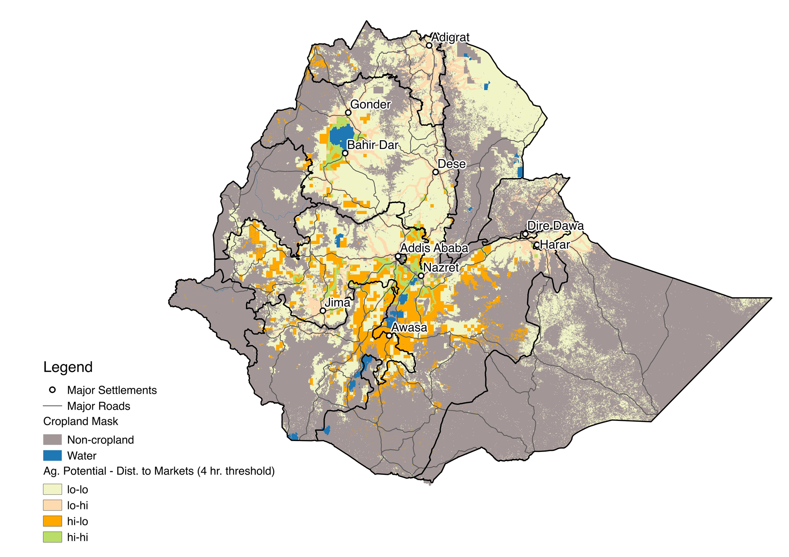
2x2 Segmentation (Ag. Potential – Distance to market): Ethiopia
Category | Units | Lo-Lo | Lo-Hi | Hi-Lo | Hi-Hi | Total
N (Ethiopia) | # | 1,536 | 593 | 526 | 236 | 2,891
HH (Ethiopia) | # | 6,717,589 | 2,298,054 | 2,389,603 | 1,005,944 | 12,411,190
HH (Ethiopia) | % | 54% | 19% | 19% | 8% | 100%
Note: Sample size (N) and extrapolated # HH are only SHF (< 4 ha)
Sources: Major Settlements – Natural Earth, 2016; Water Bodies – Digital Chart of the World, 2000; Land Suitability – FAO & IIASA, 2007; Travel Time – HarvestChoice ,2015
Notes:
3
3

